Slide 1
If the JP students came to the primary School
Notes:
Hell , my name is Thearom , President of EPS, Education for Population Support Foundation .
My presentation title is If the JP students has come.

Slide 2
Every year , Jp students has come
Notes:
Please look at this picture , you would find the JP students back of classroom.
Every year they have come to the Bongkoung primary school.
Some of them did some exhibition explaining Japanese culture or the presentation.

Slide 3
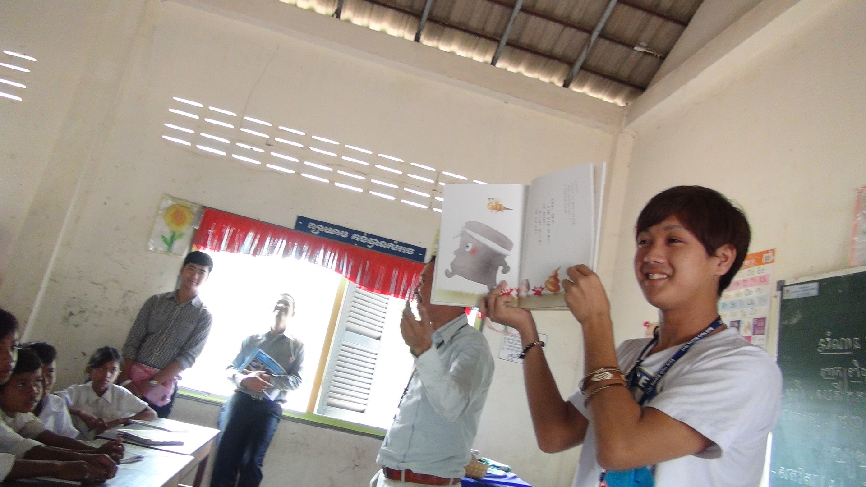
Book reading
Notes:
They tried to talk about Japanese bullet train and so on.
Introduction of Japanese culture looks so interesting for our pupils.

Slide 4
The library in school
Notes:
This library was built up by Kansai University.
For students they come to enjoy reading recognizing how language works.

Slide 5
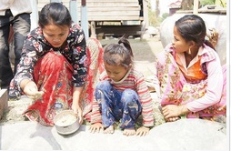
Contribution to Children aiming to change the village
Notes:
I would like to talk about what kind of work do majority-students do on their free time after school.
helping parent’s works at homes,
doing work at fields,
look after cows & buffalos,

Slide 6
Village and students
Picture of village
Notes:
Village are so poor. Their monthly income is only ???us dollars.
We have to say this small money cann’t afford to study efficiently.
Students have to help parents growing vegetables (families gardens), and seeking canes for making small flat baskets.
This picture shows the basket.
They sell it in communities and by whole sellers in the Siem Reap markets.
They need to change the lifestyles to be the intelligent persons , educated person and person who could speak English for getting Job.

Slide 7
Conclusion
the effect of university students visit
Japanese students visit surely encourage the pupils
Notes:
Uto hear I have been talking about the effect of university students visit to our school.
The Library surely enhance and help the language learning.
Japanese students visit surely encourage the pupils to broaden their lives.
That’s all thank you.

