Slide 1
What Are You Able to Contribute to the Society?
Your name
Notes:
Good Morning ,
My presentation for today is “What Are You able to Contribute to the Society?”
I would like to focus on “global Issues “ with you.

Slide 2
Global Competency
Internalize
FEEL
SEE
Notes:
Firstly I would like to talk about Global Competencies.
What comes to your mind , when we say “Global Competencies”
We have English communication skill ,ICT skill or conflict resolution skills, etc.
These are all needed when we face the global issues.

Slide 3
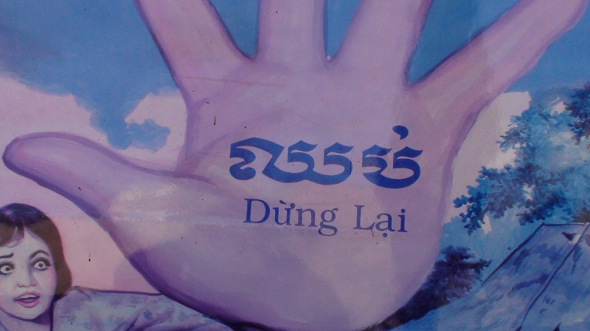
Global Issues in Cambodia
Notes:
Let me talk about global issues.
For example in Cambodia , there are lots of Issues.
1 Human trafficking, 2 sex slave caused by poverty.

Slide 4
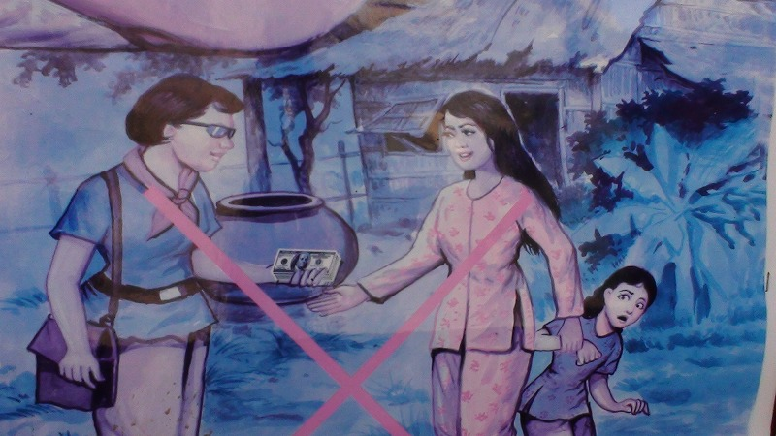
human traffic , sex slave
Notes:
Please direct your attention to this pictures.
This picture shows the propaganda that aims to prevent human trafficking.

Slide 5
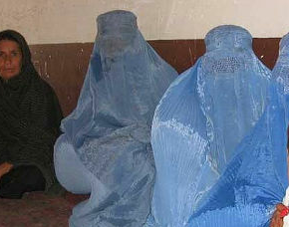
Gender issue
Afghanistan
Due to Poverty
15-16 years old girls are sold to the Rich
Against slaves
human torch suicide
硫酸 Sexism
Sexism in Pakistan
Notes:
Another example is in Afghanistan, there are 15-16 years old girls who are enforced to be the slaves for the Rich people.
In fact some of them committed human torch suicide. To prove this NHK reported that there were 7 or 8 girls who did human torch suicide even a week ago.

Slide 6
Democracy Myanmar Sep,2007 Journalist Mr.Nagai was shot by soldier 長井さん
Notes:
When it comes to Democracy.
We would never forget the incident of Mr. Nagai who was shot by the soldier in Myanmar last 2007.

Slide 7
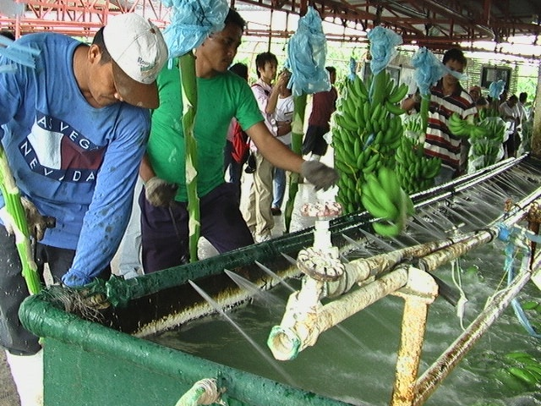
The Philippines
Notes:
Another global issue we have here is “Fair trade” which is needed in the Philippines.
Some big companies such as DOLE are expected to change their management for fare trade.

Slide 8
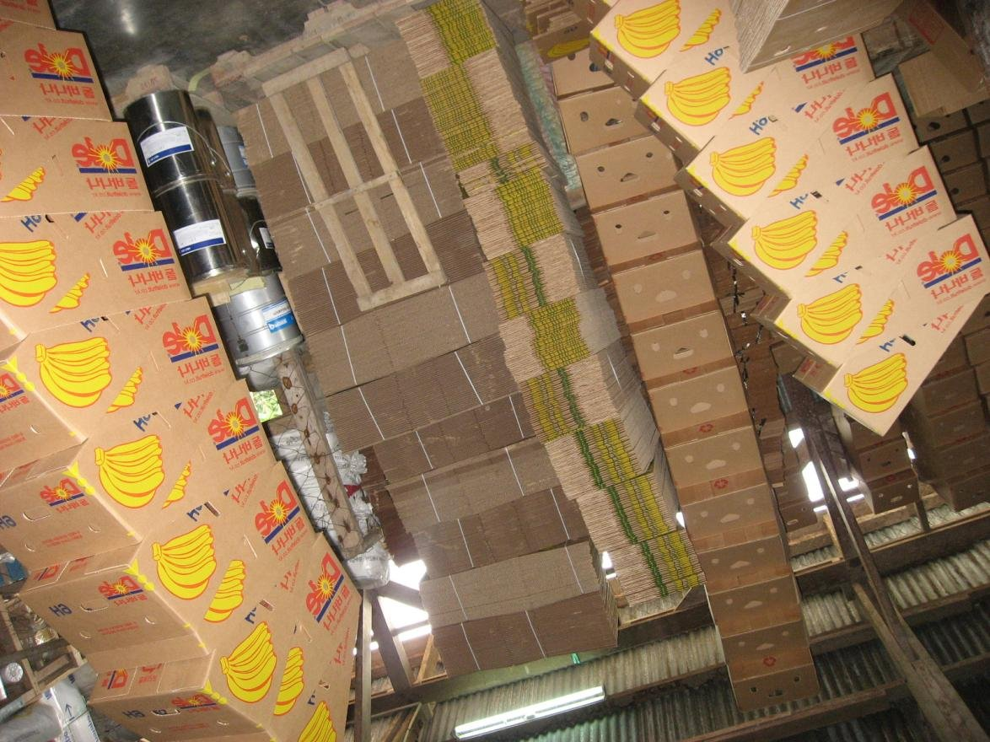
“Dole” buy one box for 2.5dollars sell it for 40 dollars
Notes:
Please take a look at this picture. There are boxes that will be sent to Japan.
“Dole” buy one box for only 2.5dollars but they sell it for 40 dollars in Japan.
I guess there should be more money which needed to be shared to Filipino people.

Slide 9
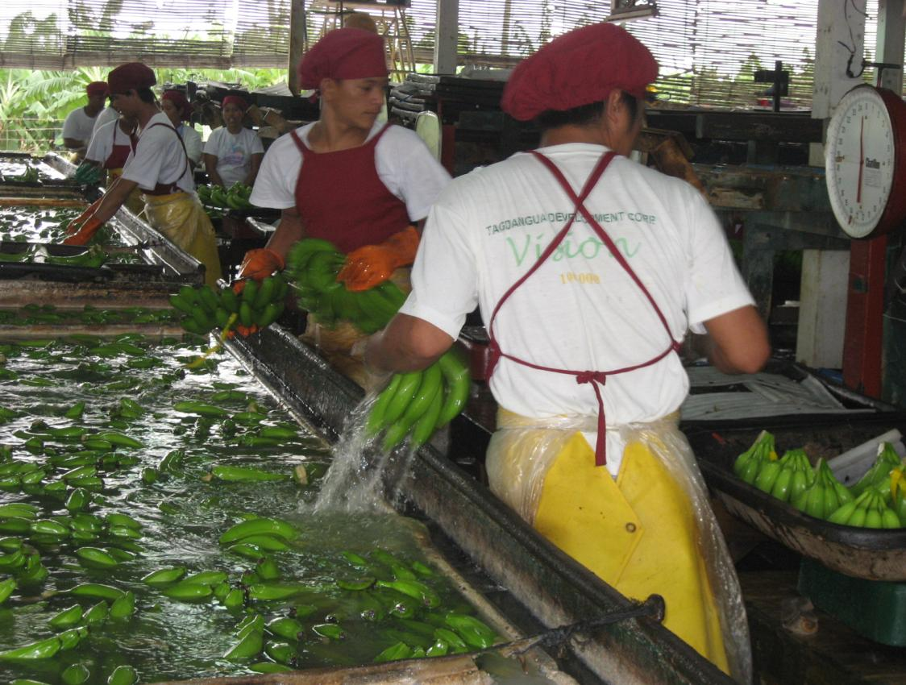
Fair-trade
Notes:
Up to here, I have been talking about the Global issues and Global competencies all around the world.
We really want to brush up our competency so that we can be the person who could contribute to those who are really in need.
That would be all thank you for your listening.

